Slide 1
Blackout Poetry
A style of Found Poetry

Slide 2
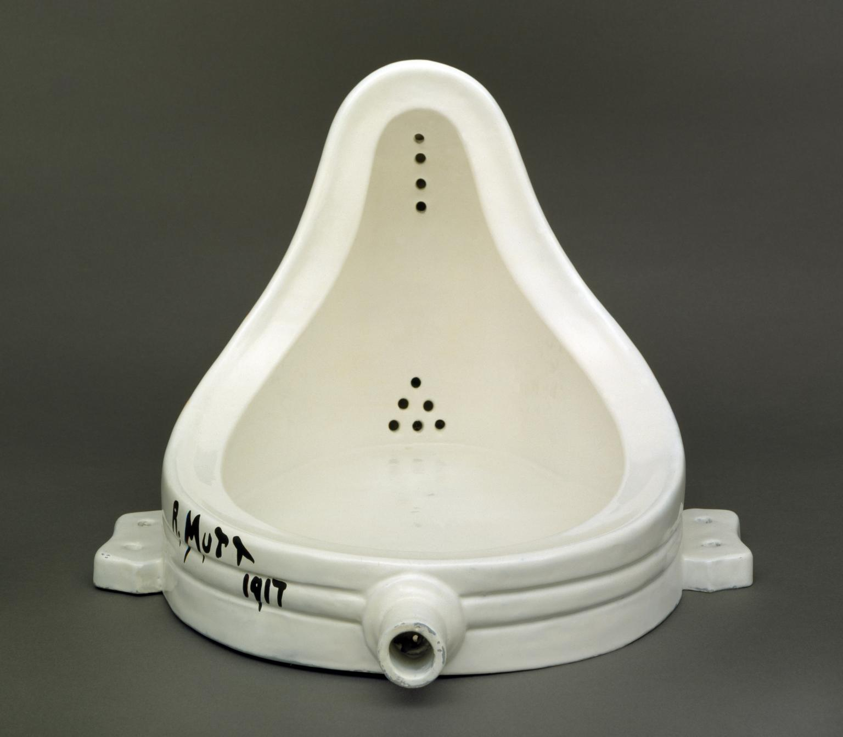
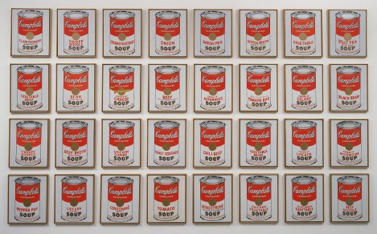
Found Object Art
Found object originates from the French objet trouvé, describing art created from undisguised, but often modified, objects or products that are not normally considered art, often because they already have a non-art function.
Duchamps
Warhol

Slide 3
Found Poetry
Found poetry is a type of poetry created by taking words, phrases, and sometimes whole passages from other sources and reframing them as poetry (a literary equivalent of a collage) by making changes in spacing and lines, or by adding or deleting text, thus imparting new meaning.

Slide 4
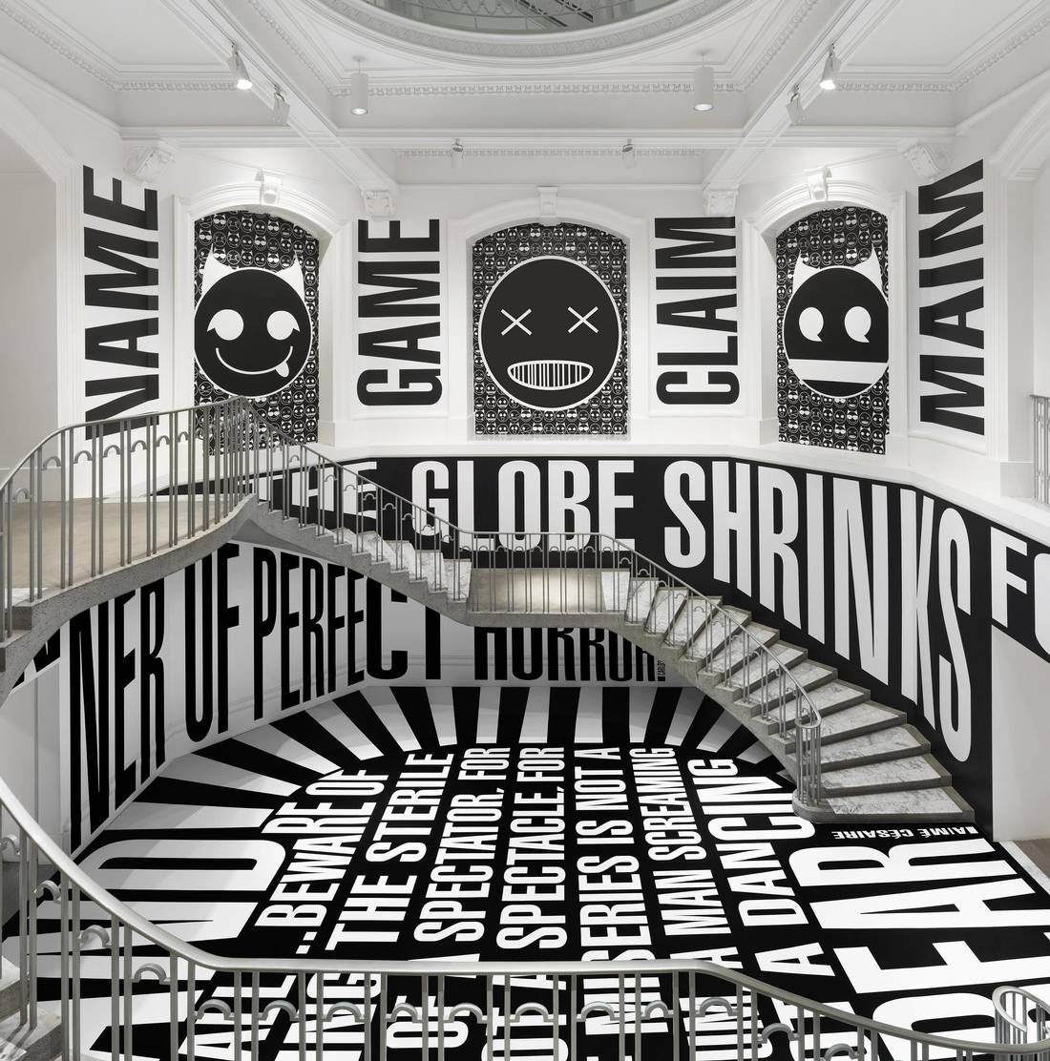
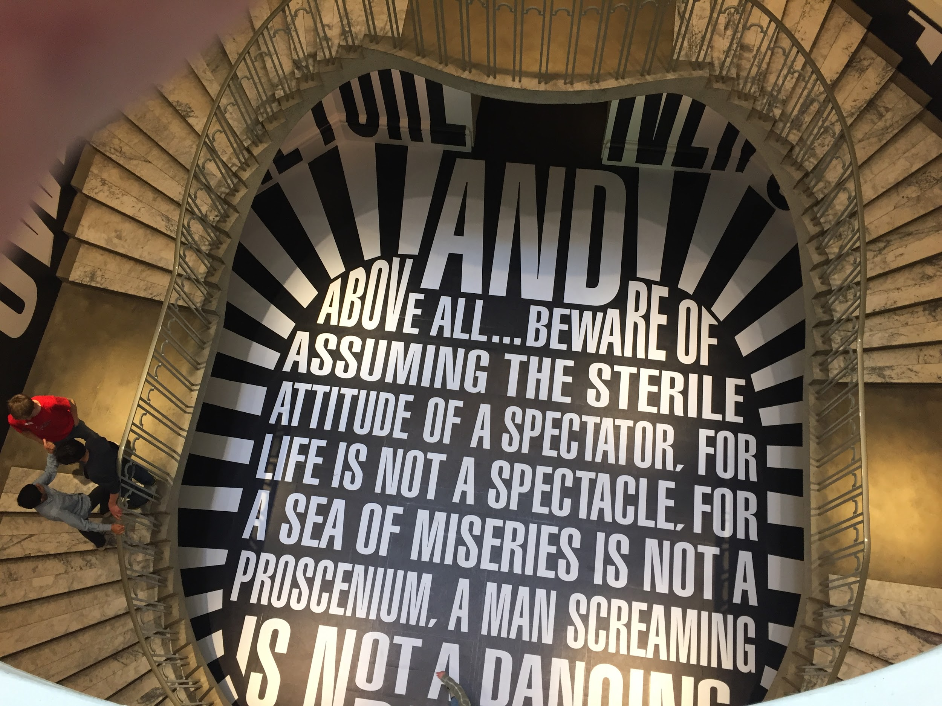
Example of Found Poetry

Slide 5
Example of Found Poetry
Hey guys, look...
...Mr. Neville ‘found poetry’!!!

Slide 6
Blackout Poetry
Blackout Poetry uses everyday texts, such as newspapers or books, to create poetry. The poet uses a black marker to “blackout” the majority of the words on the page, leaving a few words untouched that make up the lines of a poem.
The central idea is to devise a completely new text from previously published words and images, which the reader is free to interpret as she/ he wishes.

Slide 7
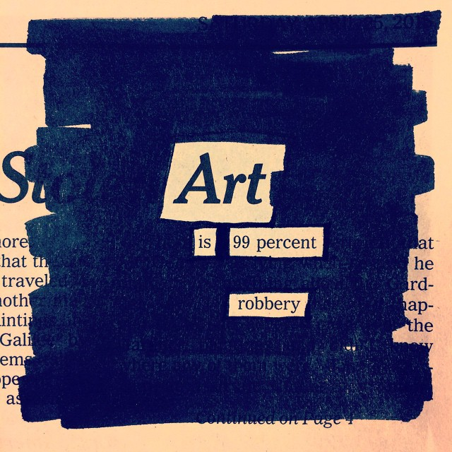
Examples of Blackout Poetry:

Slide 8
Blackout Poetry
Before even reading the text they are using, often poets begin their blackout poems by finding an anchor word that serves as the starting point and topic of the poem. This word will guide the direction of their poem. Once poets have found their anchor word, they then fully read the text that they are using, looking for words that will make up the rest of the poem.

Slide 9
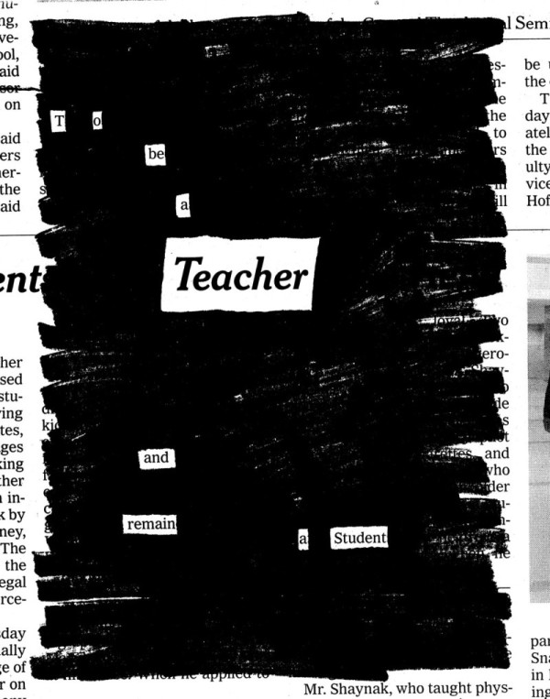
Examples of Blackout Poetry

Slide 10
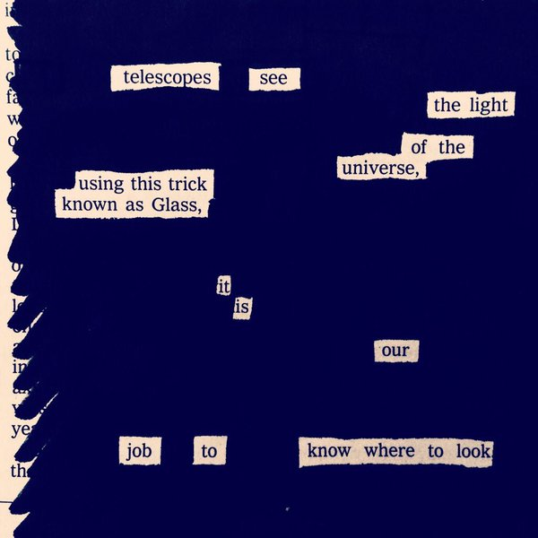
Examples of Blackout Poetry:

Slide 11
Blackout Poetry
To create a deeper meaning in blackout poetry, often poets will create an image out of the words they have blacked out. Doing so creates three levels of meaning within the text; the text's original meaning, the meaning of the words the poet has not blacked out, and the meaning of the image formed by the blackout

Slide 12
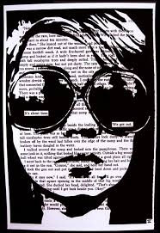
Example of Blackout Poetry

Slide 13
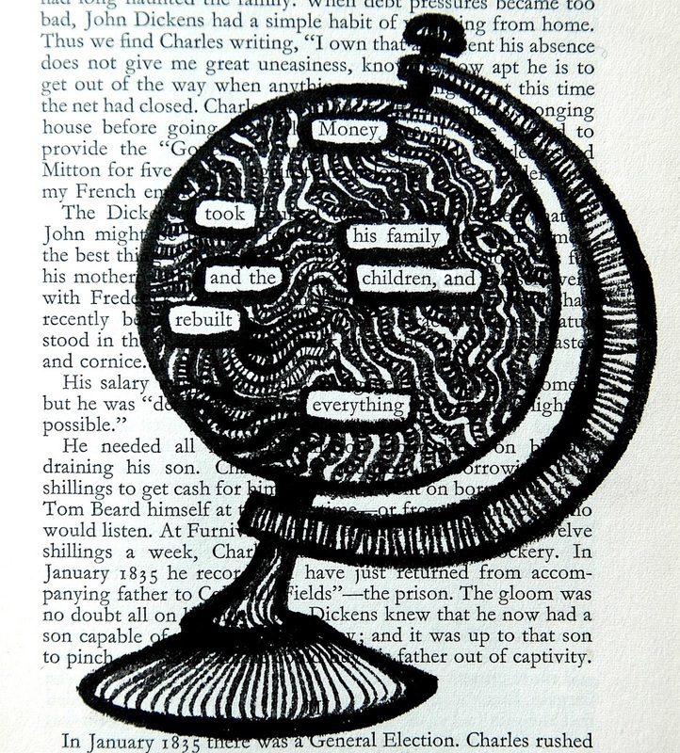
Example of Blackout Poetry

Slide 14
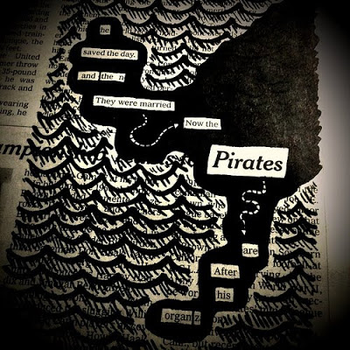
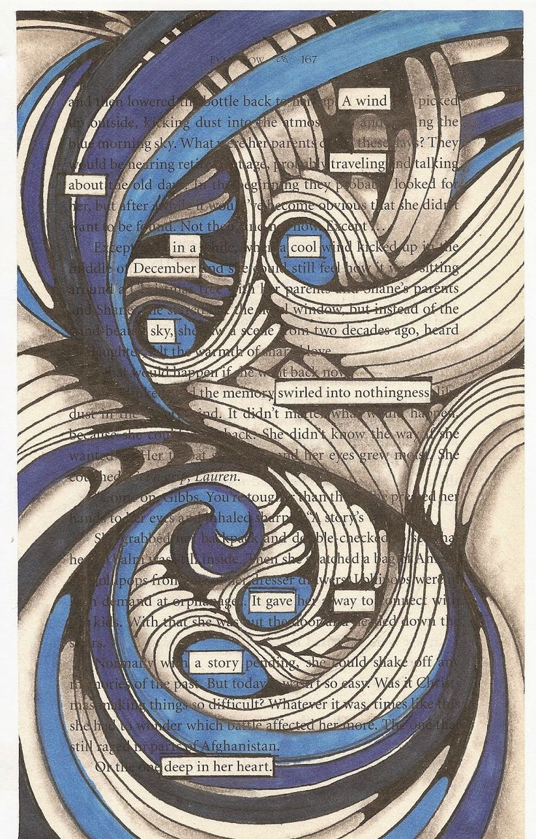
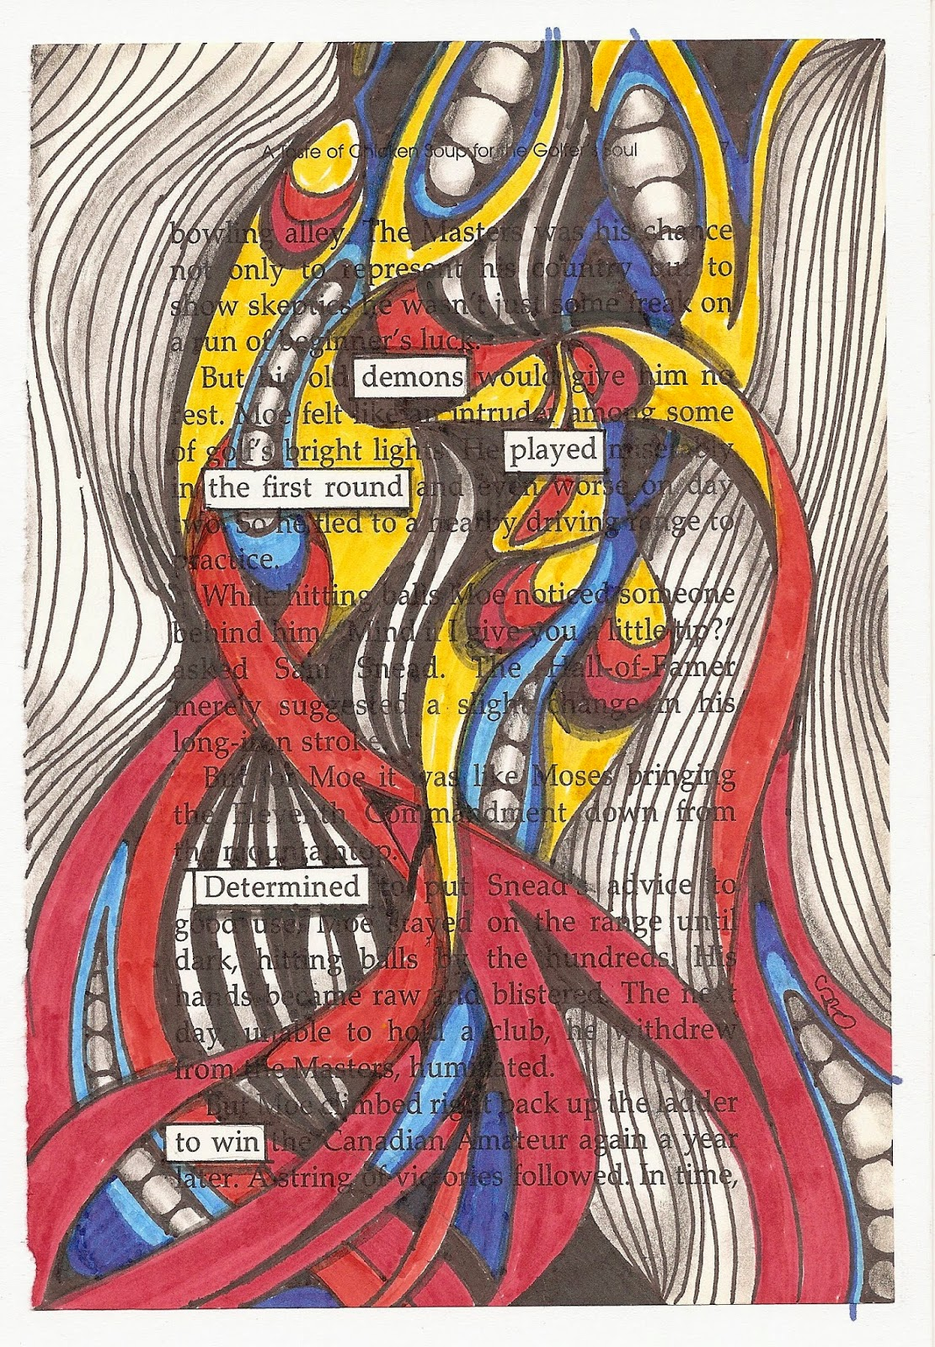
Example of Blackout Poetry

Slide 15
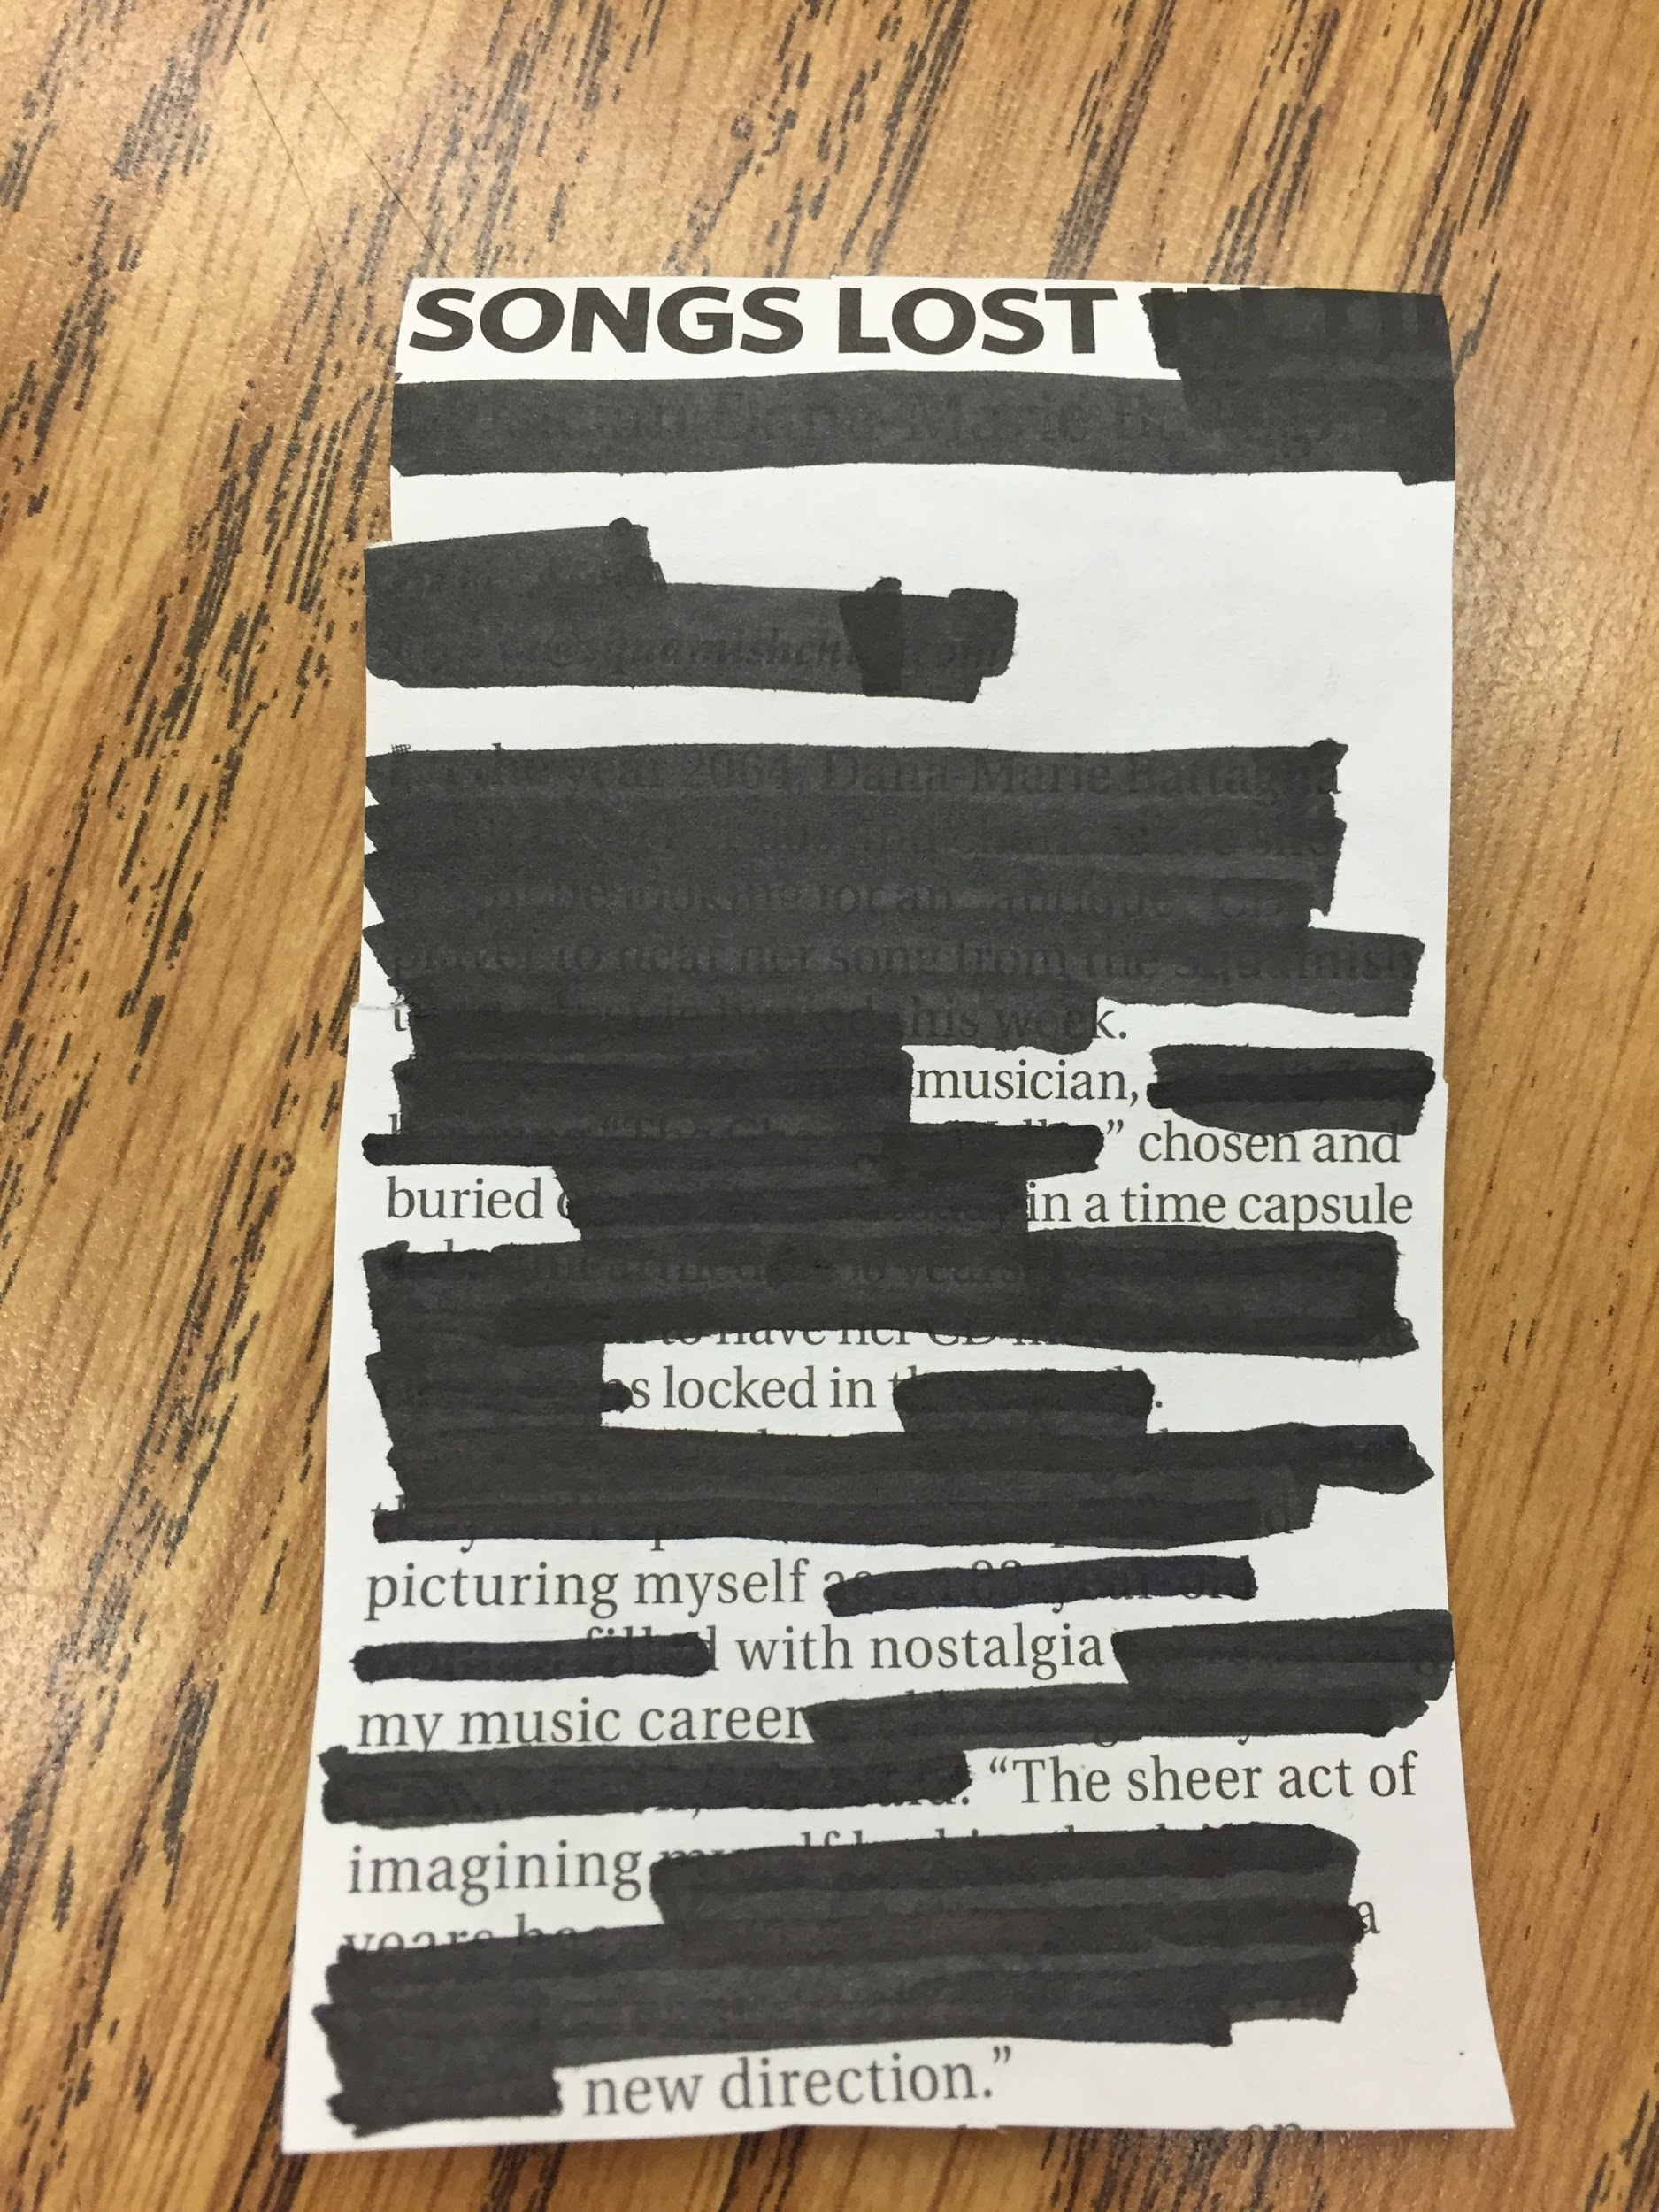
Blackout Poetry
Now, it’s time to create our own blackout poetry! Grab a newspaper and start looking for your anchor word!

